Slide 1
Caponomics 101
Components of a Contract
Presented by Jason Fitzgerald
June 14, 2013

Slide 2
What Salary is in a NFL Contract
Paragraph 5 (Base Salary)
Signing Bonus/OATSB Prorations
Roster Bonuses
Reporting Bonuses
Workout Bonuses
Likely to Be Earned (LTBE) Incentives
Not Likely to Be Earned (NLTBE) Incentives

Slide 3
Paragraph 5 Salary
Weekly earnings during course of the season
Paid in 17 equal installments
Earned at 4PM EST on Tuesday of game week
Counts in full against salary cap
Lone exception is minimum salary benefit contract
Prorated for in-season signings
League mandated minimums
The CBA states minimum payment level
Not automatically guaranteed
P5 can “split” based on roster status
P5 can escalate based on performance

Slide 4
Minimum Salary
Minimum amount team must pay a player
Every year minimums increase by $15,000
Determined by credited seasons earned
NFL treats specific groups of players equally
4-6 credited seasons
7-9 credited seasons
10+ credited seasons

Slide 5
Credited Seasons
Different than accrued seasons
Requires 3 weeks on full pay status
No credits given for weeks on:
Injured reserve
Exempt list
PUP list due to non football injury/illness
Practice Squad

Slide 6
Split Salaries
Provides protection for team
Typical in three types of contracts
Rookies drafted rounds 3-7
Players with injury history
Veterans near end of career
Different mechanisms for timings
Preseason only
Specific in-season date
Void provisions

Slide 7
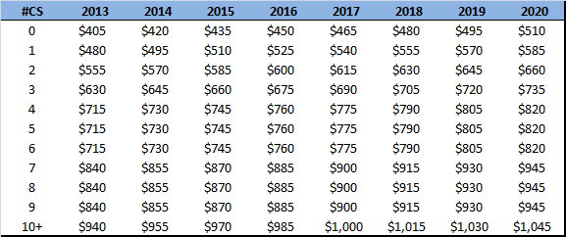
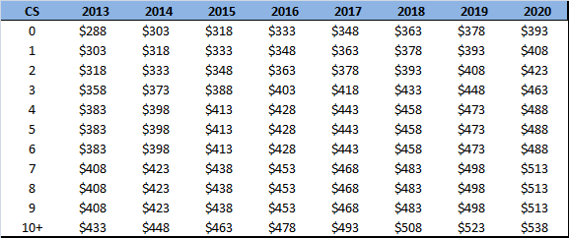
Minimum salary levels
Minimum Salaries
(all numbers 000’s)
Minimum Splits
(all numbers 000’s)

Slide 8
Guarantees
Protect a player from losing wages if cut
Fully guaranteed is ultimate protection
Skill termination
Injury termination
Salary Cap termination
Guarantees can be conditional
Earned by calendar dates
Veterans have one time termination pay guarantee
Lost by suspension or conduct
Offset Language

Slide 9
Basics of protected terminations
Skill Termination
Team determines your performance level is unsatisfactory compared to peers
Injury Termination
Player not maintaining a physical condition
Protected in-season, but not following year
Minimal injury protection for multi year injuries
Salary Cap Termination
Team needs cap room to sign who they feel are better players

Slide 10
Conditional Guarantees
Date
Earned if player is on roster 3 days after Super Bowl
Earned if player is on roster 5th day of League Year
Earned if player is on roster week 17 of preceding LY
Termination Pay
Veterans on roster in week 1 have P5 guaranteed
Veterans signed post week 1 have 25% P5 guaranteed
Can only collect once in career
Injury Protection
Salary protected if hurt during football activities
Small P5 protection (50% to appx$1 mil) in future years

Slide 11
Offset Language
No Offset Language
Ability to collect salary from multiple teams
Must be negotiated
Common for top draft picks
Can be used to attract/retain top line free agents
Offset example:
Player with $10 million in guarantees is cut
Player signs new contract worth $5 million
Player earns $5 million from each team
No offset example:
Player with $10 million in guarantees is cut
Player signs new contract worth $5 million
Player earns $10 million from old AND $5 million from new team

Slide 12
Salary Escalators/De-escalators
Salary in future increases or decreases from stated rate
Can be tied to performance/awards
Can be tied to workouts
Can be tied to position played
Proven Performance escalator for rookies
Escalators are not incentives
Earning escalator does not mean payment
Earning escalator means a chance to earn payment
Earning escalator can often spur renegotiation or release
Escalators can be guaranteed once earned

Slide 13
Minimum Salary Benefit
Helps keep veterans in the NFL
Reduces cap valuation of P5 to 2nd year levels
In 2013 $940,000 P5 = $555,000 cap charge
Must comply with specific rules to qualify

Slide 14
MSB Qualifiers
Player must have at least 4 credited seasons
P5 can’t exceed CBA minimum
Must be no longer than 1 season
No options for future years
Additional compensation no greater than
$65,000 (2012-14)
$80,000 (2015-17)
$95,000 (2018-20)
Includes money earned from other teams
Guarantees can not exceed salary of 2nd year player

Slide 15
MSB Example
Qualifying player:
Seasons: 8
Contract Length: 1 year
Paragraph 5: $840,000
Offseason bonuses: $65,000
Guaranteed P5: $555,000
Cap and Cash Calculation
Cash Value: $840,000 + $65,000 = $905,000
Cap Value: $555,000 +$65,000= $620,000
Player Benefit: $905,000-$620,000 = $285,000

Slide 16
Prorated Bonuses
Lump sums promised to a player
Not necessarily paid at signing
Do not count in full against salary cap in multiyear contract
Remain with player even if cut
Signing bonuses subject to forfeiture on proportionate basis
Others subject to forfeiture if breach occurs in season of payment
Salary Cap treatment
Prorated over remaining contract up to 5 years
Unaccounted for money accelerates (dead money) if player removed from roster
Examples
Signing bonus
Option bonus
Non-exercise fee
Salary advance
Unconditional fully guaranteed offseason bonus
Guaranteed completion bonus
Difference between 1st and 2nd year salary when 2nd year is 50% less than 1st year
Salary increase in contract executed after week 10
Roster bonus in season of signing if signed after Preseason completion

Slide 17
Prorated bonus accounting
Signing Bonus example
Signing bonus amount: $5 million
Contract length: 4 years
Yearly cap charge: $5,000,000/4= $1,250,000

Slide 18
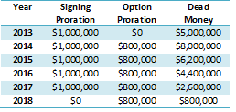
Prorated bonus accounting
Signing and Option Bonus example
Contract length: 6 years
Signing bonus: $5 million
Option Bonus: $4 million (due 2014)

Slide 19
Acceleration
Cap charge of unaccounted for dollars if player is released
Cut between start of LY and June 1
All unaccounted for money counts on cap
Cut after June 1
Only current years proration counts towards cap
All future money accelerates to following season

Slide 20
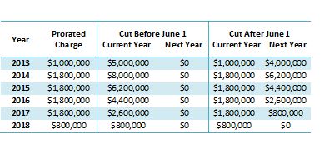
Acceleration Example
Assume same contract in prior option examples
June 1 treatment is simply difference between before June 1 and Prorated Charges

Slide 21
Roster Bonus
Paid for specific roster status on specific date
Offseason
Preseason
In-season
Post-season
Can be player or team friendly
Earlier the date the more player friendly
Counts in full against cap except
When fully guaranteed (treated as prorated bonus)
When tied to games active (treated as LTBE/NLTBE)
Subject to forfeiture

Slide 22
Reporting Bonus
Paid for reporting to training camp
Mechanism to prevent holdouts
Counts in full against cap except
When fully guaranteed (treated as prorated bonus)
Subject to forfeiture

Slide 23
Workout Bonus
Contracted payments for attending percentage of offseason workouts
Every player eligible for per diem pay
$175 per workout in 2013
Amount increases $20 every other year
Mechanism to entice participation in voluntary offseason programs
Counts in full against cap except
When fully guaranteed (treated as prorated bonus)
Not subject to forfeiture

Slide 24
Incentives
Bonuses earned in a league year for meeting specific performance thresholds
Incentives can be
Team performance
Individual performance
Combinations of team and individual
Honors
CBA mandates the criteria
Categories are explicit
Player can only qualify for team based if normal position or 15% snaps
League disallows special teams playtime bonus unless 50% playtime year before
League dictates “official” statistics
League certifies “official media” awards
Cap treatment based on prior years achievements
LTBE counts towards current years salary cap
NLTBE does not count toward current years salary cap

Slide 25
Acceptable Incentives
Team Performance
Points scored, points allowed, TDs scored, Td’s allowed, net yards, sacks, net yards per play, pass % completed, punt return average, kick return average, wins, playoffs, playoff levels, return TD’s, net takeaways
Individual Performance
Total yards, yards per run, Td’s, passer rating, completion %, interception percentage, yards per pass, receptions, yards per catch, interceptions, interception return yards, fumble recoveries, fumble return yards, sacks, punt return average, kickoff return average, field goals, field goal percentages, gross punt average, net punt average, punts inside 20, playing time, weight clause
Honors
Pro Bowl, ALL NFL, All conference, MVP, Super Bowl MVP, Offensive and Defensive Player of the Year, NFL Player of the Year

Slide 26
LTBE Cap Treatment
Incentives are typically valued based on prior year performance
Cap treatment does not prohibit nor guarantee earning
Certain incentives are always LTBE
Incentives in renegotiated contract signed during season
Weight clause
Leading team in punting/kicking
Minimal team performance (i.e. 30th best offense)
Team ranking within a division

Slide 27
LTBE/NLTBE Examples
Player has the following incentives in 2013:
Pro Bowl: $1 million
50% playtime: $500,000
75% playtime: $750,000 (inclusive)
1,250 rushing yards: $500,000
Roster Bonus: $12,500 per game active 46 man roster
Player had following statistics in 2012
Pro Bowl: Yes
Offensive Plays: 749
Team Offensive Plays: 1,000
Rushing yards: 1,201
Games Active: 14
Cap treatment
Pro Bowl: $1 million
Playtime: $500,000
Rushing yards: $0
Roster Bonus: $175,000
Total LTBE: $1,675,000 (counts towards cap)
Total NLTBE: $775,000 (does not count towards cap)

Slide 28
LTBE/NLTBE Adjustments
NLTBE’s actually earned:
Roster bonuses immediately impact the cap
Incentives paid immediately impact the cap
Per game/play bonuses immediately impact the cap
Renegotiations post incentive criteria being met immediately impact the cap
Player cut/traded post criteria being met immediately impact the cap
All others are accounted after the season
LTBE’s not earned
Accounted for after the season
Final Adjustment
Difference LTBEs unearned and NLTBE’s earned is positive an upward adjustment made to following years team salary cap
If difference is negative and causes team to exceed cap a downward adjustment is made to following years team salary cap

Slide 29
Putting it all together
Sample Contract
Length: 4 Years (2013-2016)
P5: $3, $4, $5, and $6 million
Signing bonus: $4 million
Roster bonus: $1 million (2014)
Workout bonus: $100,000 (2013-16)

Slide 30
Putting it all together
Sample Contract
Length: 6 Years (2013-2018)
P5: $3, $4, $5, $6, $3, and $3 million
Signing bonus: $4 million
Option bonus: $5 million (2014)
Roster bonus: $2 million (2014), $5 million (17-18)
Per game roster bonus: $12,500 (2013-2018)
Workout bonus: $100,000 (2013-18)
Incentives: $500,000 (80% snaps); $1 million (10
sacks); $500,000 Pro Bowl
Prior Year: 15 games, 810/990 snaps, 9 sacks,
no Pro Bowl

Slide 31
Putting it all together
Valuation Notes
Bonuses only prorate over 5 years
Per game roster bonuses based on 15 games
Only incentive that is LTBE is $500,000 playtime
Remaining incentives are NLTBE and do not count against the cap

Slide 32
Putting it all together
What happens to future years if in 2013:
Appears in 13 games
Selected to the Pro Bowl
Plays in 732/1010 snaps
Records 10.5 sacks

Slide 33
Questions or Comments?
E-mail: Jason@overthecap.com
Website: www.overthecap.com
Twitter: jason_OTC
Facebook: overthecap fan page

